Slide 1
UNIQUE SOCIAL IMPACT PROPOSITION (USIP) DESIGN FRAMEWORK
BY DR. NOEL AKPATA

Slide 2
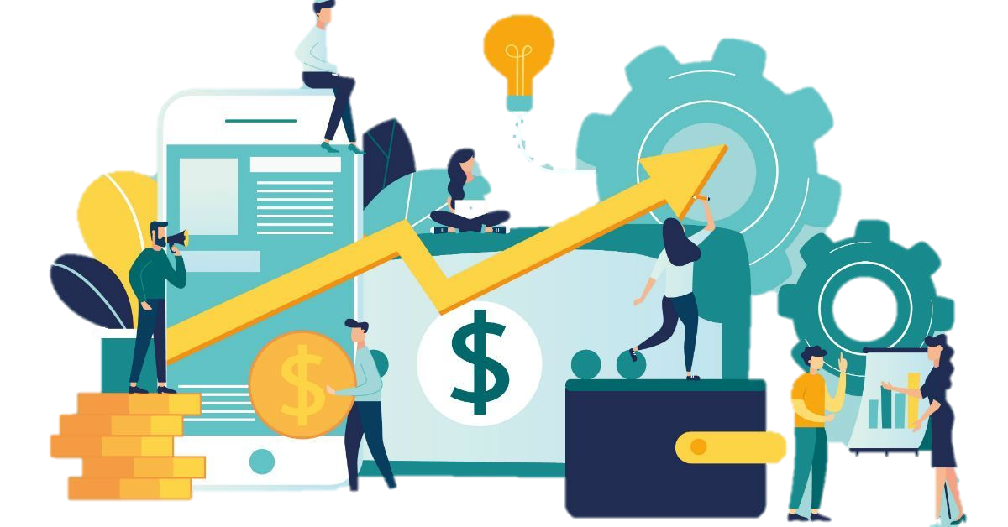
Level One
Board/CEO – USIP MATCHING
What should be the Unique Social Impact Proposition of this company?

Slide 3
Board/CEO – USIP Matching
Why are we doing so many impact initiatives and not globally known and recognized for any particular one

Slide 4
Level Two
PRE USIP IMPACT ANALYSIS
How has our previous scatter shot social impact initiatives affected our brand, image, positioning, sales?

Slide 5
PRE USIP Impact Analysis
How will the new consolidated social impact proposition help us occupy spaces in the minds of our consumers over the long term.

Slide 6
Level Three
USIP Culture Infusion
How can we mobilize the whole organization around this new USIP framework and strategy

Slide 7
USIP Culture Infusion
How can we attract and keep new talent based on this USIP. Talents who are connected to our organization beyond monetary reasons.

Slide 8
Level Four
USIP Project Design and Management
social impact project design and analysis, critical stakeholder immersion

Slide 9
USIP Project Design and Management
Robust content marketing strategy development and social capital formation tracking (telling our impact story and measuring how our impact story is occupying brand spaces in the minds of our consumers)

Slide 10
USIP Project Design and Management
Social Capital Induced Transaction Cost Gains

Slide 11
USIP Project Design and Management
Social capital-Hard Capital Interconversion strategy and implementation.

